Slide 1
Open RAN and GlowSea
Dian Hanifudin Subhi

Slide 2
Outline
Weekly report
Summary of this week’s work
Your work
Conclusion
Your opinion/thought
Action item

Slide 3
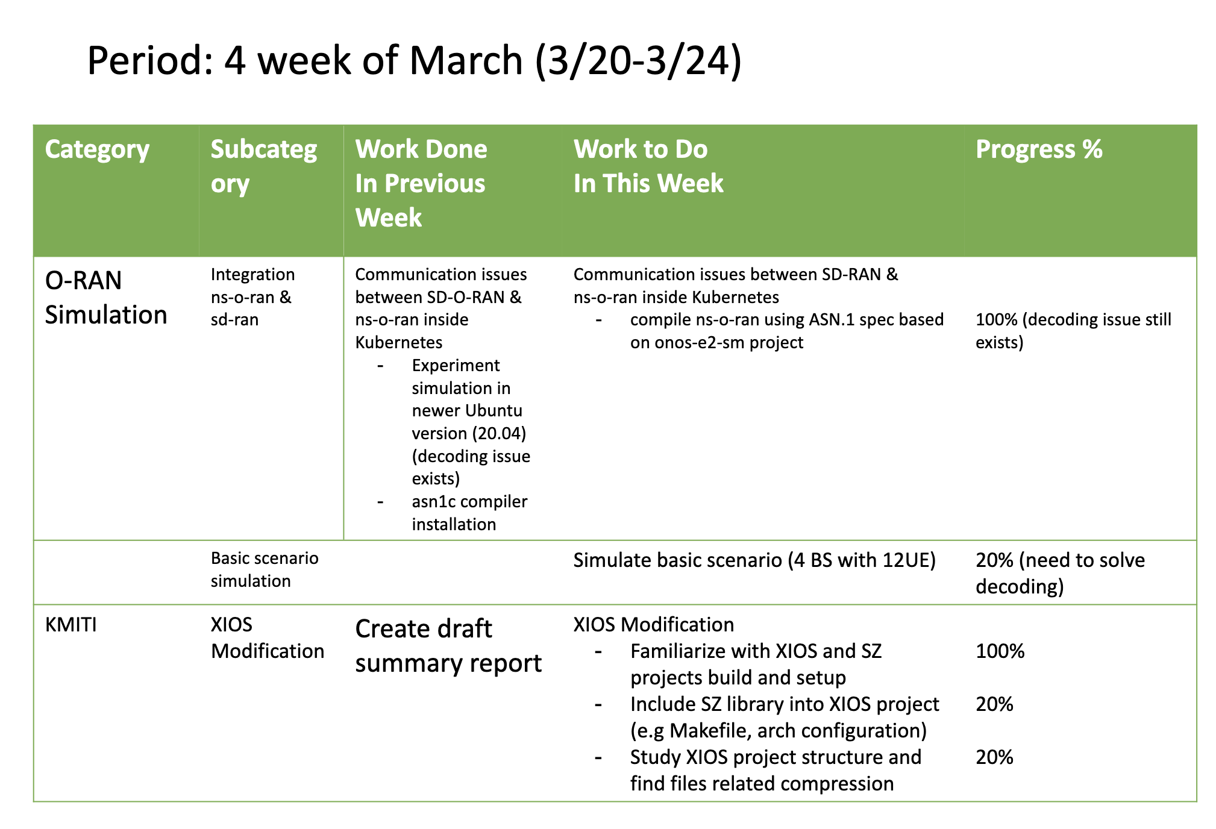
Weekly report

Slide 4
Summary of work this week
Troubleshooting decoding and trying simulation with basic scenario
Study about XIOS modification related to SZ compression

Slide 5
Question to be Answered
How is the progress of ns3 integration with SD-RAN?
What modification is needed to apply SZ compression?

Slide 6
ns3 integration
Compiling KPM one of E2SM
Compiling e2sim using new KPM is successful but the decoding issue still exist when decoded the message

Slide 7
SZ setup
SZ setup
git clone https://github.com/szcompressor/SZ
cd SZ
./configure --enable-fortran
make
sudo make install

Slide 8
XIOS setup
XIOS setup
Setup reference: https://nemo-related.readthedocs.io/en/latest/compilation_notes/nemo37.html
svn checkout http://forge.ipsl.jussieu.fr/ioserver/svn/XIOS/branchs/xios-2.0 xios-2.0
cd xios2.0/arch
cp arch-GCC_LINUX.env arch-GCC_local.env
cp arch-GCC_LINUX.fcm arch-GCC_local.fcm
cp arch-GCC_LINUX.path arch-GCC_local.path

Slide 9
XIOS setup
Adjust arch-GCC_local.env
# old config
export HDF5_INC_DIR=$HOME/hdf5/hdf5/include
export HDF5_LIB_DIR=$HOME/hdf5/hdf5/lib
export NETCDF_INC_DIR=$HOME/netcdf4/include
export NETCDF_LIB_DIR=$HOME/netcdf4/lib
export BOOST_INC_DIR=$HOME/boost
export BOOST_LIB_DIR=$HOME/boost
# new config
export HDF5_INC_DIR=$HOME/hdf5/hdf5/include
export HDF5_LIB_DIR=$HOME/hdf5/hdf5/lib
export NETCDF_INC_DIR=$HOME/netcdf4/include
export NETCDF_LIB_DIR=$HOME/netcdf4/lib
export BOOST_INC_DIR=$HOME/boost
export BOOST_LIB_DIR=$HOME/boost

Slide 10
XIOS setup
Running make_xios
XIOS provided make_xios script to generate Makefile and download dependencies based on the flag argument.
Run make_xios script
./make_xios --full --prod --arch GCC_local -j2 |& tee compile_log.txt

Slide 11
Link SZ into XIOS
Modify CFLAGS
SZ library prefix installed on /usr/local
Add variable inside the arch-GCC_lorcal.env related with SZ library
# new config
export HDF5_INC_DIR=/usr/local/include
export HDF5_LIB_DIR=/usr/local/lib
export NETCDF_INC_DIR=/usr/local/include
export NETCDF_LIB_DIR=/usr/local/lib
export BOOST_INC_DIR=/usr/local/include
export BOOST_LIB_DIR=/usr/local/lib
export SZ_INC_DIR=/usr/local/include
export SZ_LIB_DIR=/usr/local/lib

Slide 12
Link SZ into XIOS
Modify CFLAGS
Add additional variable inside arch-GCC_local.path
Add flag to linked SZ library -lSZ
NETCDF_INCDIR="-I $NETCDF_INC_DIR"
NETCDF_LIBDIR="-L $NETCDF_LIB_DIR"
NETCDF_LIB="-lnetcdff -lnetcdf"
MPI_INCDIR=""
MPI_LIBDIR=""
MPI_LIB="-lcurl"
HDF5_INCDIR="-I $HDF5_INC_DIR"
HDF5_LIBDIR="-L $HDF5_LIB_DIR"
HDF5_LIB="-lhdf5_hl -lhdf5 -lhdf5 -lz"
BOOST_INCDIR="-I $BOOST_INC_DIR"
BOOST_LIBDIR="-L $BOOST_LIB_DIR"
BOOST_LIB="”
SZ_INCDIR=“-I $SZ_INC_DIR”
SZ_LIBDIR=“-L $SZ_LIB_DIR”
SZ_LIB=“-lSZ”
OASIS_INCDIR="-I$PWD/../../oasis3-mct/BLD/build/lib/psmile.MPI1"
OASIS_LIBDIR="-L$PWD/../../oasis3-mct/BLD/lib"
OASIS_LIB="-lpsmile.MPI1 -lscrip -lmct -lmpeu"

Slide 13
Link SZ into XIOS
Modify CFLAGS
add SZ header file into nc4_data_output.hpp
#include “sz.h”
Rerun make_xios to get new Makefile
./make_xios --full --prod --arch GCC_local -j2 |& tee compile_log.txt

Slide 14
Link SZ into XIOS
mpicc -o nc4_data_input.o -DUSING_NETCDF_PAR -I/home/dhs/Workspaces/hpclab/kmiti/xios/inc -ansi -w -O3 -DBOOST_DISABLE_ASSERTS -I /usr/local/include -I /usr/local/include -I/home/dhs/Workspaces/hpclab/kmiti/xios/extern/boost -I/home/dhs/Workspaces/hpclab/kmiti/xios/extern/blitz -I /usr/local/include -I/home/dhs/Workspaces/hpclab/kmiti/xios/extern/src_netcdf4 -I/home/dhs/Workspaces/hpclab/kmiti/xios/extern/boost/include -I/home/dhs/Workspaces/hpclab/kmiti/xios/extern/rapidxml/include -I/home/dhs/Workspaces/hpclab/kmiti/xios/extern/blitz/include -c /home/dhs/Workspaces/hpclab/kmiti/xios/src/data_input.cpp
touch /home/dhs/Workspaces/hpclab/kmiti/xios/flags/CFLAGS__xios__nc4_data_output.flags
touch /home/dhs/Workspaces/hpclab/kmiti/xios/flags/CPPKEYS__xios__nc4_data_output.flags
gmake: *** No rule to make target 'sz.h', needed by ‘nc4_data_output.o'. Stop.
gmake -f /home/dhs/Workspaces/hpclab/kmiti/xios/Makefile -j 1 all failed (2) at /home/dhs/Workspaces/hpclab/kmiti/xios/tools/FCM/bin/../lib/Fcm/Build.pm line 597.
Build failed on Thu Mar 23 03:49:12 2023.
->Make: 74 seconds
->TOTAL: 78 seconds
Monitor log_compile.txt
No rule to make target ‘sz.h’, needed by `nc4_data_output.o’
It’s means the generated of Makefile still wrong, because the compiler can’t recognize the SZ header file

Slide 15
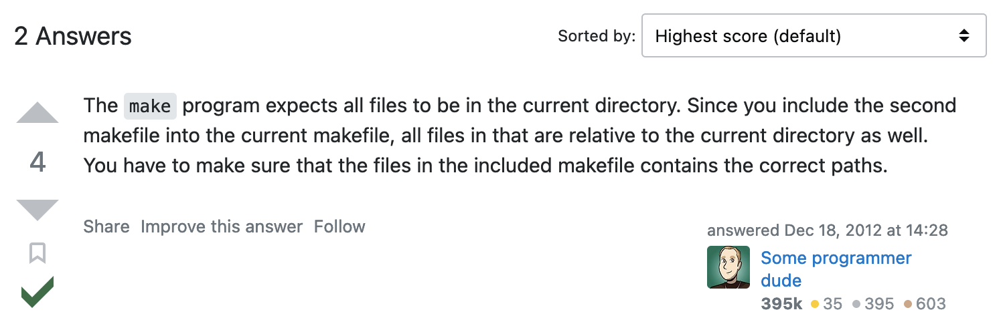
Link SZ into XIOS
Troubleshooting
Clone the SZ project into XIOS/extern/SZ
Remodify arch-GCC_local.env, then replace /usr/local/include with ${PWD}/extern/SZ
But the compilation error still exist because the compiler can’t recognize SZ library

Slide 16
Link SZ into XIOS
Troubleshooting
Include SZ header file using absolute path
#include ”/usr/local/include/sz.h”
Rerun make_xios script again
The compilation script is error, but the compiler can recognize the SZ library
fcm_internal load:F zzz server_main.o xios_server.exe
ar: creating /home/dhs/xios-2.0_clena/tmp/lib__fcm__xios_server.a
mpif90 -o xios_server.exe /home/dhs/xios-2.0_clena/obj/server_main.o -L/home/dhs/xios-2.0_clena/lib -l__fcm__xios_server -Wl,'--allow-multiple-definition' -L /lib -L /lib -L /lib -L /lib -lnetcdff -lnetcdf -lhdf5_hl -lhdf5 -lhdf5 -lz -lmpi -lstdc++
/usr/bin/ld: cannot find -lnetcdff
/usr/bin/ld: cannot find -lhdf5_hl
/usr/bin/ld: cannot find -lhdf5
/usr/bin/ld: cannot find -lhdf5
collect2: error: ld returned 1 exit status
fcm_internal load failed (256)
/home/dhs/xios-2.0_clena/Makefile:7902: recipe for target 'xios_server.exe' failed
gmake: *** [xios_server.exe] Error 1
gmake -f /home/dhs/xios-2.0_clena/Makefile -j 1 all failed (2) at /home/dhs/xios-2.0_clena/tools/FCM/bin/../lib/Fcm/Build.pm line 597.
Build failed on Thu Mar 23 08:32:16 2023.
->Make: 872 seconds
->TOTAL: 876 seconds

Slide 17
XIOS modification
Find related function to output
NEMO using netcdf4 as output format
The file of XIOS project related netcdf4 is nc4_data_output.hpp and nc4_data_output.cpp
Grep nc4_data_output.hpp with keyword: write, compress, deflate

Slide 18
XIOS modification
Plan
Implement SZ compression outside XIOS
Implement SZ compression using netcdf4 input file outside XIOS project
Migrate the previous implementation into XIOS project
Simulate using NEMO model

Slide 19
Conclusion
Decoding issue still occurred when decode the message
SZ linked to XIOS project using absolute path
Understanding about the logic inside nc4_data_output.hpp and nc4_data_output.ccp is mandatory to implement SZ compression.

Slide 20
Your opinion/thought
Grep with keyword of write/compress inside XIOS is needed
Find similar project related with the implementation of SZ compression

Slide 21
Action items
Trial and error to solve decoding communication issue
Learn the SZ compression related function using SZ API library
Further action and direction based on Professor decision.

